Slide 1
Decision-Feedback Equalizer (DFE)
Circuit Implementation Background

Slide 2
Basic Idea

Slide 3
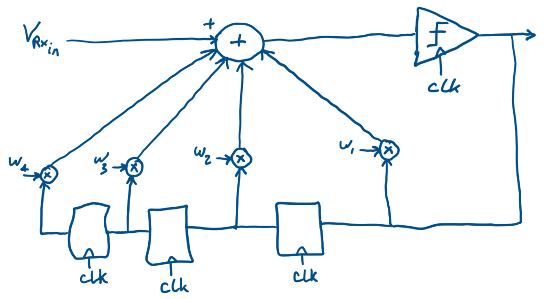
Basic Idea
[1] From “EE 290C - High-Speed Electrical Interface Circuit Design” Course, Lec. 8, by Dr. Elad Alon

Slide 4
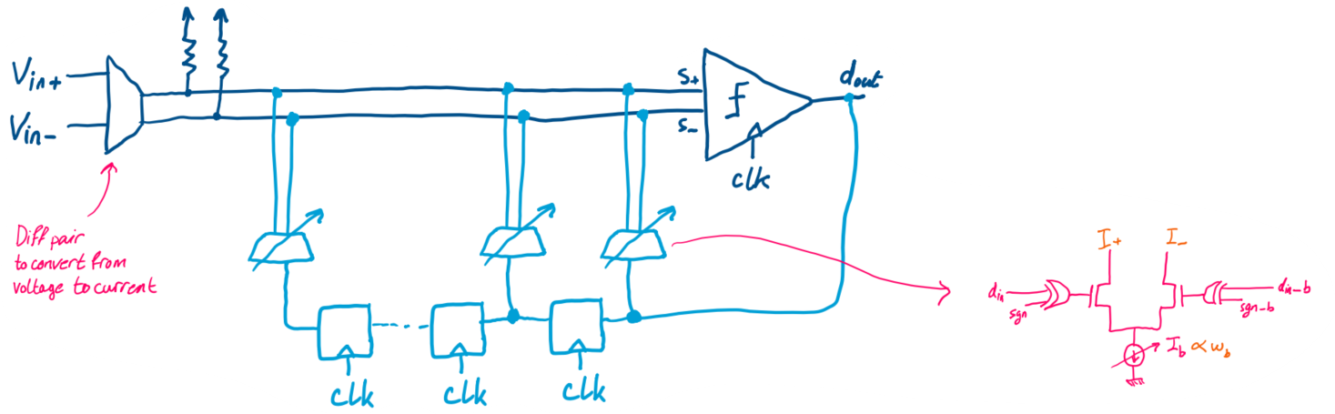
Implementation
[1] From “EE 290C - High-Speed Electrical Interface Circuit Design” Course, Lec. 8, by Dr. Elad Alon

Slide 5
DFE using a FF as a delay cell & a Slicer

Slide 6
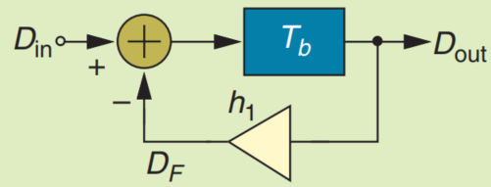
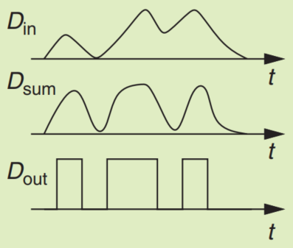
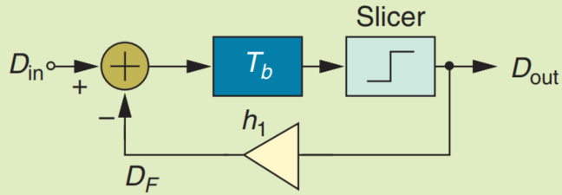
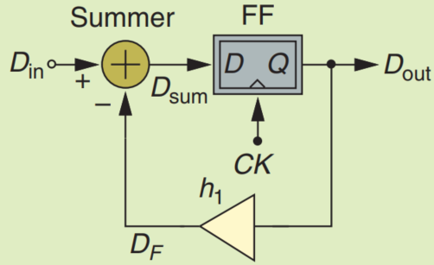
Design Stages
(a) A feedback loop canceling the first postcursor
(b) the addition of a slicer to suppress amplitude noise
(c) the use of an FF as a delay element and a slicer
[2] From [A Circuit For All Seasons] “The Decision-Feedback Equalizer” – by Dr. Behzad Razavi

Slide 7
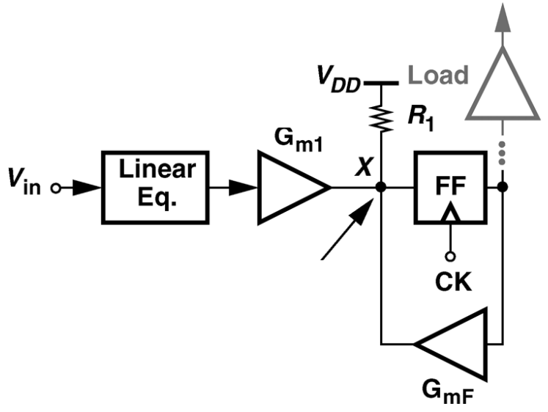
Circuit Implementation
Summing point
[3] S. Ibrahim & B. Razavi, "Low-Power CMOS Equalizer Design for 20-Gb/s Systems," in IEEE Journal of Solid-State Circuits

Slide 8
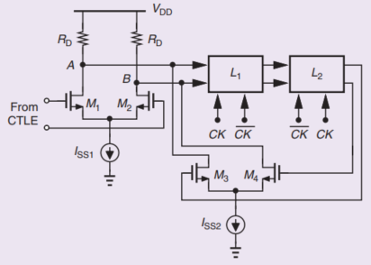
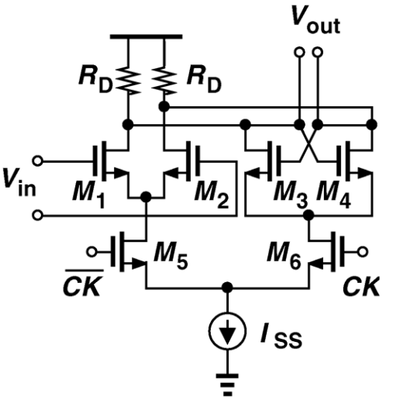


Circuit Implementation
Summing point
Current-Steering Latch
$$G_{m1}$$
$$G_{mF}$$
[4] From [The Analog Mind] “The Design of an Equalizer—Part Two” – by Dr. Behzad Razavi

